Slide 1




Introduction to Web Development
Attendance
linktr.ee/CODE.CRUNCH

Slide 2
Week #9
Mastering CSS Grid and Combining it with Flexbox for Complex Layouts

Slide 3
Introduction to the Week’s Topic
Overview: This week focuses on advanced CSS layout techniques, specifically CSS Grid and how to combine it with Flexbox for complex, responsive layouts.
Real-World Relevance:
Building modern, flexible websites requires mastering advanced layout techniques.
CSS Grid is becoming a standard for creating two-dimensional layouts, while Flexbox works best for one-dimensional layouts.
Combining both creates powerful, responsive layouts that adapt to any screen size.

Slide 4
Key Concepts for Today’s Lecture
Concepts Covered:
CSS Grid: The core concepts of the CSS Grid layout model.
Combining Flexbox and Grid: How to use both layout systems together for complex designs.
Practical Examples: Demonstrating how CSS Grid can be applied to various real-world scenarios.

Slide 5
Introduction to CSS Grid
What is CSS Grid?
CSS Grid is a two-dimensional layout system that allows you to design both rows and columns simultaneously, making it ideal for building complex, responsive grid-based layouts.
hy Use CSS Grid?
Easy alignment: Align content both horizontally and vertically with just a few properties.
Precise control: Manage the size, spacing, and placement of grid items across both axes.

Slide 6
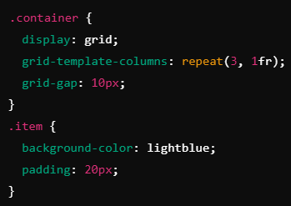

Slide 7
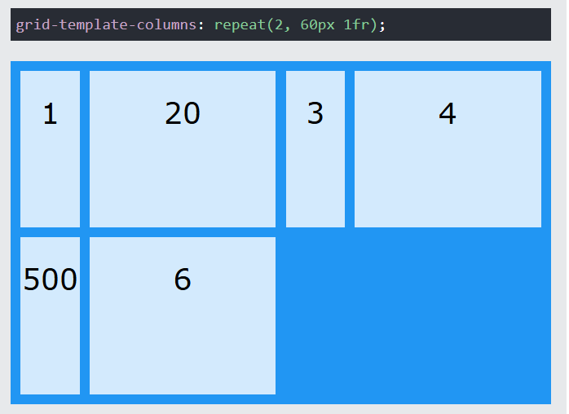
The code grid-template-columns: repeat(2, 60px 1fr); makes a grid with 4 columns. The first column is 60px wide, the second takes up extra space. Then, it repeats that pattern. So, you get 60px, more space, 60px, and more space.

Slide 8
Meaning of ‘fr’
In CSS Grid's grid-template-columns, the fr unit signifies a "fraction" of the available space within the grid container, allowing for flexible and responsive layouts where columns can dynamically adjust to the available space.
grid-template-columns: 1fr 1fr 1fr; divides the available space into three equal columns.
grid-template-columns: 1fr 2fr; allocates one fraction of the space to the first column and two fractions to the second column.

Slide 9
Core CSS Grid Concepts
Grid Container vs. Grid Items:
The container is the parent element with display: grid, and the items are the children that will be placed inside the grid.

Slide 10
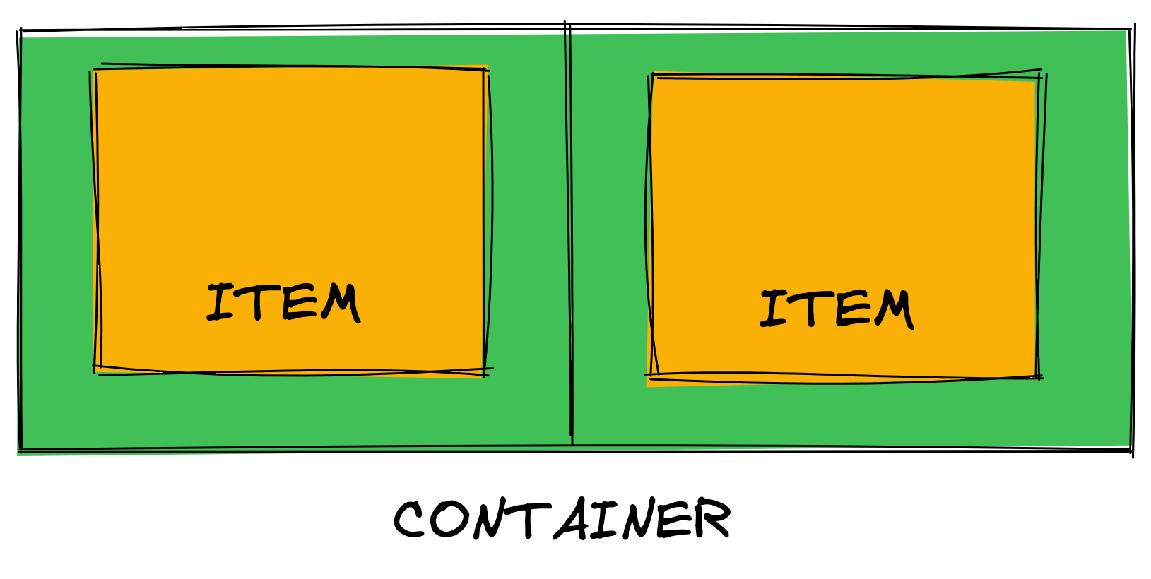

Slide 11
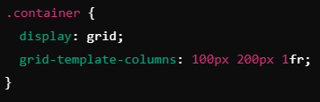
Defining Rows and Columns
You can define how many rows and columns your grid should have using grid-template-rows and grid-template-columns. Imagine a box (.container). We're dividing it into columns: one is 100 steps wide, another 200 steps, and the last one fills the rest!

Slide 12
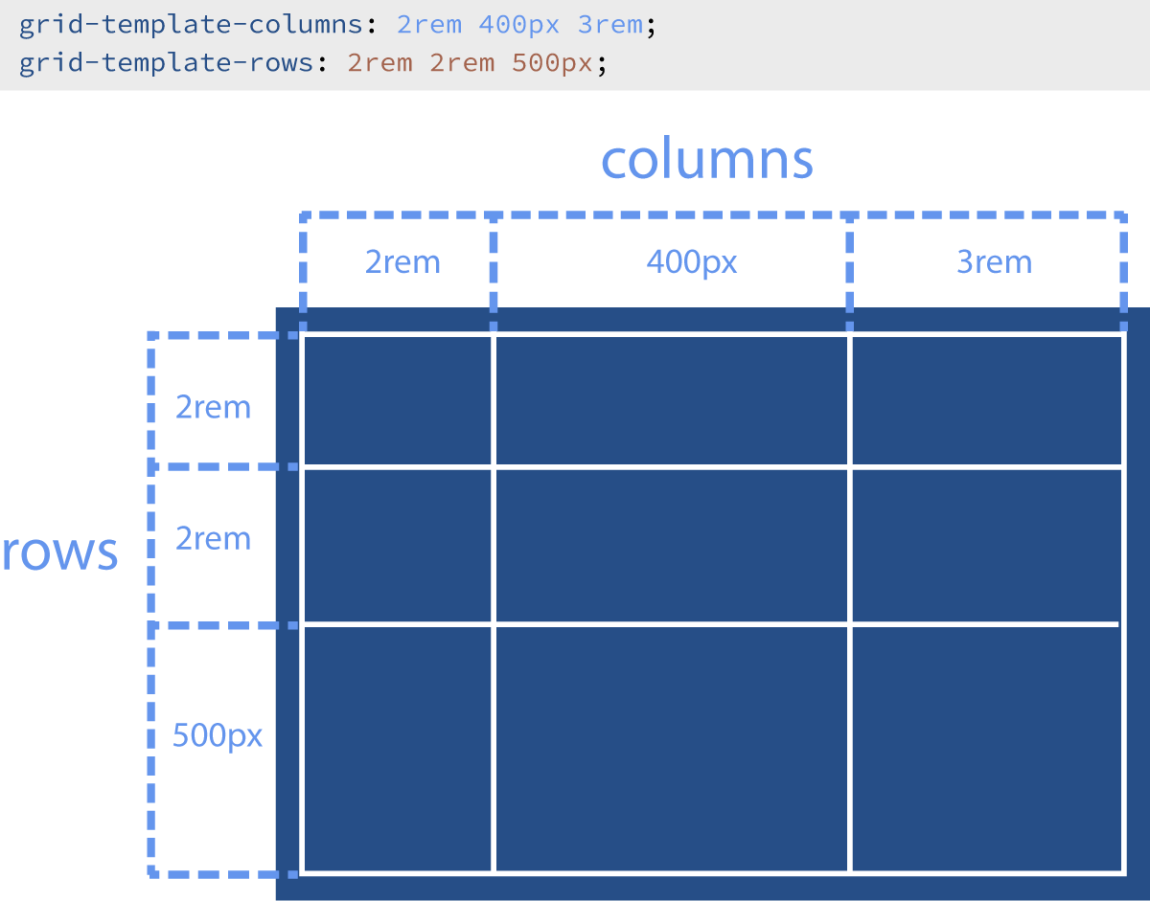
grid-template-columns: 2rem 400px 3rem; divides the table into three vertical columns. The first is 2rem wide, the second 400px, and the third 3rem.
grid-template-rows: 2rem 2rem 500px; divides the table into three horizontal rows. The first two are 2rem tall, and the third is 500px.

Slide 13
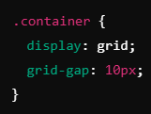
Grid Gaps
Use grid-gap to define the space between grid items:
Think of it like a checkerboard, with 10 tiny spaces between each square!

Slide 14
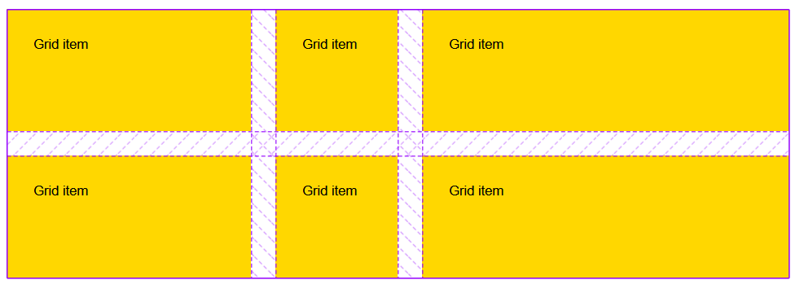
GRID GAP equal length of 10 spaces between each

Slide 15
Advanced Grid Features

Slide 16
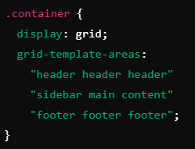
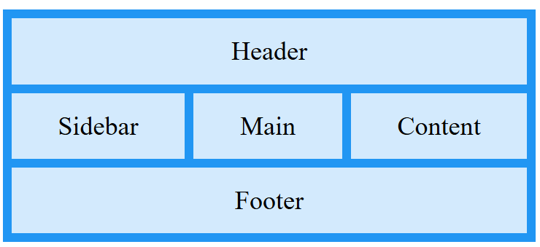
Grid Lines, Areas, and Naming:
Grid lines: These define where rows and columns start and end.
Grid areas: You can name areas in the grid to simplify placement.

Slide 17
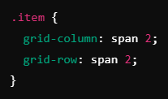
Spanning Multiple Rows/Columns
Items can span across multiple rows or columns.

Slide 18
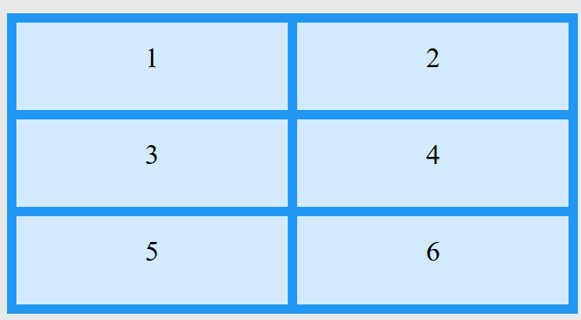
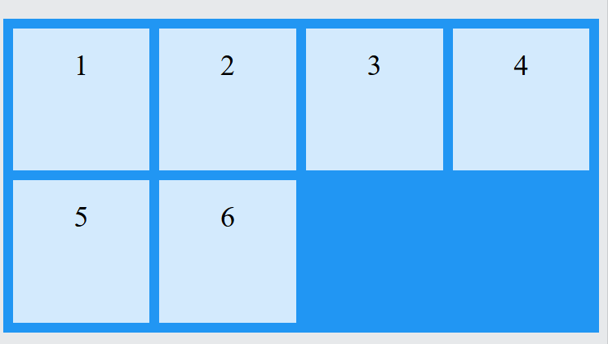
Now each item takes up two spaces on column and two spaces on rows

Slide 19
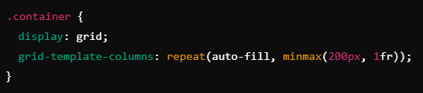
Auto-fill and Auto-f
Use auto-fill and auto-fit for responsive grid items that adjust to the screen size.

Slide 20
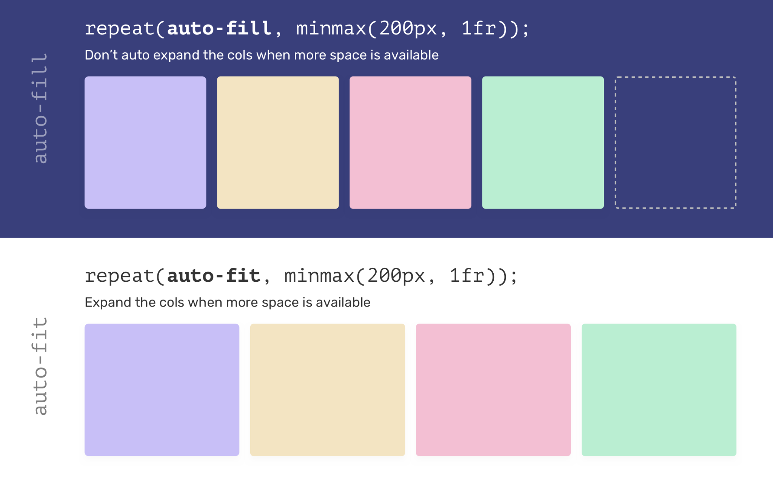
Difference AUTOFILL v AUTOFIT

Slide 21
Combining Flexbox and CSS Grid
Why Combine Flexbox and Grid?
While CSS Grid is great for two-dimensional layouts, Flexbox excels at one-dimensional layouts. Combining both allows for complex, flexible layouts that adapt to varying screen sizes.
For instance, use CSS Grid for the overall page layout and Flexbox for the individual components inside the grid.
Real-World Example:
A two-column layout with CSS Grid, and inside each column, use Flexbox for alignment and spacing of items.

Slide 22
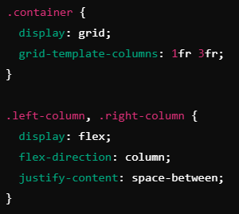

Slide 23
Practical Example: Building a Page Layout with Grid and Flexbox

Slide 24
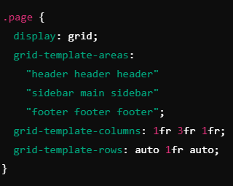
Grid for Structure:
Define the page layout with a grid, creating areas for a header, sidebar, main content, and footer.

Slide 25
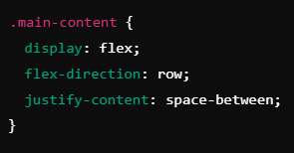
Flexbox for Content Alignment:
Inside the main content area, use Flexbox to align text, images, or cards in a row or column format.

Slide 26
Best Practices and Common Pitfalls
Best Practices:
Use CSS Grid for complex layouts with rows and columns.
Use Flexbox for simple, one-dimensional layouts within grid items.
Make use of grid areas to simplify layout placement.
Common Pitfalls:
Overcomplicating layouts: Don’t use Grid for simple, one-dimensional layouts.
Forgetting to add grid-gap to improve spacing between items.

Slide 27
Real-World Example
Case Study: An online store layout using CSS Grid for the main structure and Flexbox for individual product cards.
Grid Layout: Dividing the page into header, sidebar, content, and footer.
Flexbox Layout: Aligning product images and text descriptions within product cards.

Slide 28
Summary of Key Points
CSS Grid: Powerful for building two-dimensional layouts with fine control over rows, columns, and areas.
Flexbox: Best suited for one-dimensional layouts, aligning content in rows or columns.
Combining Grid and Flexbox: Utilize both systems together for flexible and responsive designs.

Slide 29
Coding Lab

Slide 30
Introduction to the Coding Lab
Objective: In this lab, you will create a complex layout using CSS Grid for the overall structure and Flexbox for aligning content inside grid areas.
Skills Covered:
Implementing a two-dimensional layout using CSS Grid.
Using Flexbox within grid items for alignment and spacing.

Slide 31
Task 1 - Create HTML
We begin by setting up the basic HTML structure. This includes a <head> section for metadata and a <body> section for content. We will focus on creating a layout structure using a grid container and individual grid items.

Slide 32
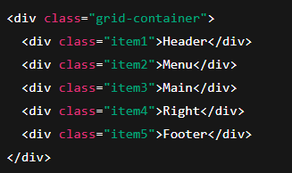
Within <body></body> tags

Slide 33
Task 2 - Setting Up the CSS Grid
Next, we will write the CSS code to define how these elements should be arranged on the page using CSS Grid.
Create a style.css file and add the following CSS code:

Slide 34
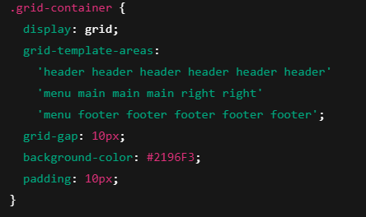

Slide 35
Task 3 - Styling the Grid Items
Next, let’s style the individual grid items. Each grid item is represented by a <div> element inside the grid container. We’ll add some basic styling like background color, padding, and font size.

Slide 36
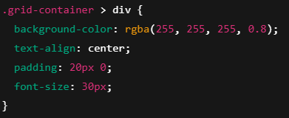

Slide 37
Task 4 - Assigning Grid Areas to Each Item
To ensure each item is placed in the correct area, we will use the grid-area property. This allows us to assign specific names to the areas inside the grid layout.

Slide 38
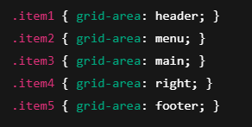

Slide 39
Task 5 - Testing Responsiveness
To ensure that the grid layout works well on different screen sizes, you can add some responsiveness to the grid layout. For example, you can use media queries to modify the layout for smaller screens.

Slide 40
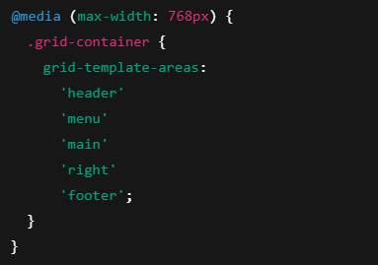

Slide 41
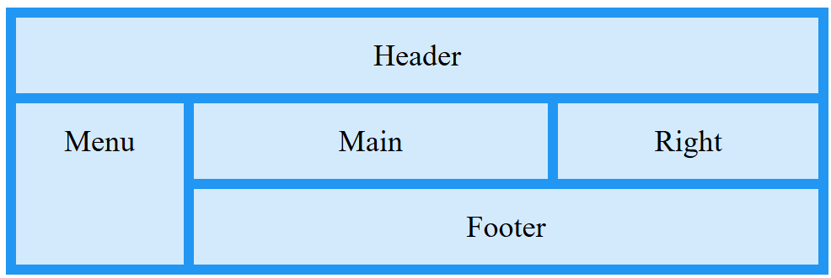
DESKTOP View
Screen Size > 768PX

Slide 42
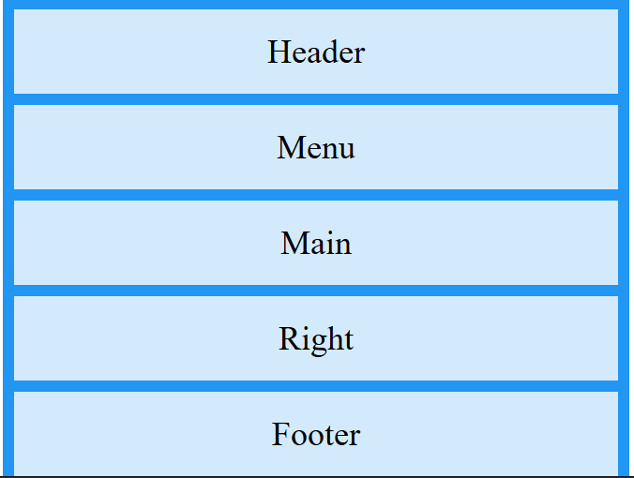
MOBILE View
Screen Size < 768PX

Slide 43
Q & A Session

Slide 44

https://github.com/CODE-CRUNCH-CLUB/C8-CRUNCH-LABS-WEB-DEV

Slide 45





Attendance
Join us for the next sessions
Check our schedule on Discord “Schedule” Channel
RSVP lu.ma/CODECRUNCH
Your feedback helps us improve. Share your thoughts! Go to our website: go.fiu.edu/codecrunch
linktr.ee/CODE.CRUNCH

